Slide 1
Level Descriptors: KS3 Programming
Level 3 Create a linear program incorporating basic user inputs and outputs Declare and assign information to variables Concatenate strings with information assigned to variables
Level 4 Identify the need to store information with different data types Use IF and ELSE statements to make decisions Use WHILE and FOR loops for iterative processes Use the: ‘equal to’, ‘not equal to’, ‘greater than’ and ‘less than’ comparison operators
Level 5 Use subroutines to create efficient programs and reduce duplication of code Use 1-dimentional arrays to store and retrieve information Use bitwise operators: ‘AND’ & ‘OR’ as part of conditions to be evaluated
Level 6 Use of functions which take arguments and return values to create efficient programs Use of 2-dimentional arrays to store and retrieve information Begin to create algorithms within programs to perform specific functions

Slide 2

Microsoft® Small Basic
Introduction to Small Basic
Estimated time to complete this lesson: 30 minutes

Slide 3

Introduction to Small Basic
In this lesson, you will learn how to:
Describe Small Basic.
Explore the Small Basic environment.
Write a Small Basic program.
Use IntelliSense® technology.
Save your program.

Slide 4
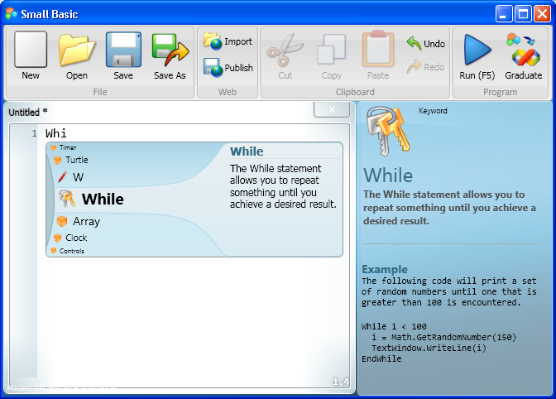
What is Small Basic?
A program is a set of instructions that a computer can understand. To write that set of instructions, you use a programming language.
Small Basic is a programming language…
…that makes computer programming extremely approachable, easy, and fun!

Slide 5

Small Basic − A Programming Language for Beginners
In the beginning, only a few programming languages existed, and they were easy to learn. However, these languages became more and more complex, such as the Microsoft Visual C#® development tool, the Microsoft
Visual Basic® development environment, and Java.
This complexity discouraged people who wanted to learn how to program computers.
Small Basic removes this complexity barrier and serves as a stepping stone for all beginners to the world of programming!

Slide 6
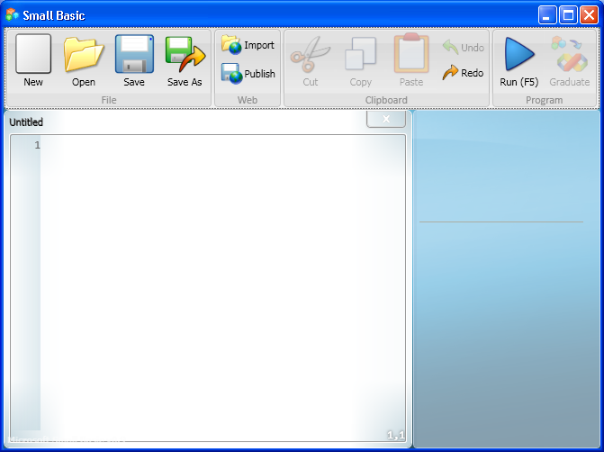
The Small Basic Environment
Small Basic provides you with an extremely simple yet powerful development environment with features like instant context-sensitive help.
1. You write your Small Basic programs in the Editor.
2
3
2. You can run various commands by clicking buttons on the Toolbar.
1
3. As you write code, you can find information about commands in the Help window.
Notes:
Let’s explore the different elements of the environment where you write and run your Small Basic programs.
You can open and work with multiple Editor windows at one time.
The Editor window that contains the program you are currently working with is the active Editor.
You can indent your program code more consistently by highlighting it, right-clicking it, and then clicking Format Program.

Slide 7
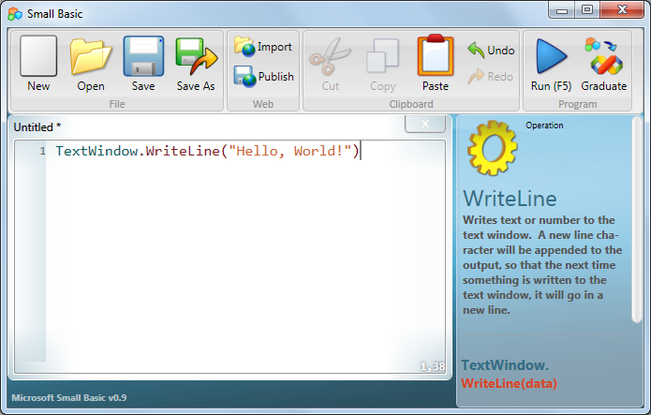

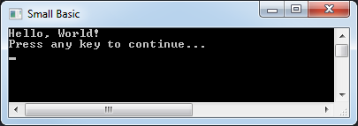
Your First Program
Now that you’re familiar with the environment, you are ready to start programming!
As you know, the Editor is where you write your programs. So, let’s write the following line in the Editor: TextWindow.WriteLine(“Hello, World!")
You have created your first program, and now you can run it and check the result!
output
Click the button on the Toolbar.
Notes:
You can run your program either by clicking Run on the Toolbar or by pressing F5 on the keyboard.
In the next lesson, you will analyze a program in detail to learn more about it.
Code:
TextWindow.WriteLine("Hello, World!")

Slide 8
TextWindow.WriteLine(“Hello, World!")

Slide 9
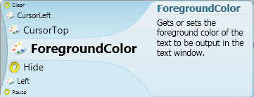
IntelliSense − Making It Easy
While you were typing, did you notice that a list of items appeared with their explanations?
These items are part of an “IntelliSense” list, which you can use to type your programs faster.
An IntelliSense list contains commands that you can type. You can scroll through the list by pressing the UP and DOWN arrows on your keyboard, and you can press ENTER to insert the highlighted command into your code.

Slide 10
Saving Your Program
After you write a program, you must save it if you want to change or run it later.
To save your program, you can click Save on the Toolbar, or you can hold down the CTRL key on the keyboard while you press the “S” key.
Notes:
You should save your program frequently so that you do not lose your work if the power fails or your computer suddenly shuts down.
Code:
TextWindow.WriteLine("Greetings to All")

Slide 11

Let’s Summarize…
Congratulations!
Now you know how to:
Define Small Basic.
Explore the Small Basic environment.
Write a Small Basic program.
Use IntelliSense.
Save your program.

Slide 12

Show What You Know
Now that you know some facts about Small Basic, you can demonstrate what you’ve learned by answering the following questions:
What is Small Basic?
Which feature of Small Basic helps you type your program faster?
How do you run your Small Basic program?
Notes:
Answers:
A programming language.
IntelliSense.
By clicking Run on the Toolbar or by pressing F5 on the keyboard.

Slide 13
Microsoft® Small Basic
Statements, Properties, and Operations
Estimated time to complete this lesson: 1 hour

Slide 14
Statements, Properties, and Operations
In this lesson, you will learn about:
Statements in Small Basic programs.
Properties of the TextWindow object.
Operations of the TextWindow object.

Slide 15
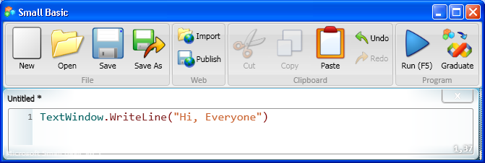
Statements in Small Basic Programs
When you give an instruction to the computer, you create a statement. You can write a program by creating just one statement or by creating two or more statements in a particular sequence.
For example, you can instruct the computer to open a text window and write "Hi, Everyone" in it. To give this instruction, you write the following statement in the Editor:
Notes:
One ore more statements make up a program in Small Basic. The computer runs a program by reading and understanding each statement line by line.
For example, this screen displays the statement: TextWindow.WriteLine("Hi, Everyone")
This statement tells the computer to write the line of text, Hi, Everyone, in the text window.

Slide 16
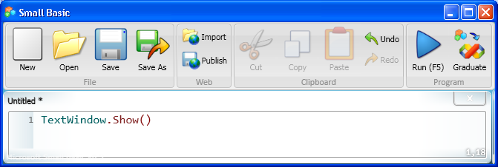
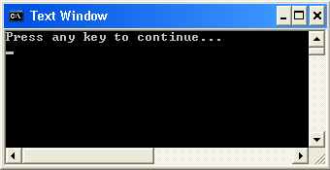
Showing and Hiding the Text Window
The text window is an object, and you can instruct the computer to perform operations on that object. For example, you can display the TextWindow object by using the Show operation.
output
Click the button on the Toolbar.
Similarly, you can hide the TextWindow object by using the Hide operation.
Notes:
Let’s see how you can show or hide the text window.
First, type TextWindow.Show() in the Editor, and then click Run on the Toolbar. The result of your program is that the text window appears.
Similarly, you can hide the text window if you type the statement TextWindow.Hide() in the Editor and then click Run on the Toolbar.

Slide 18
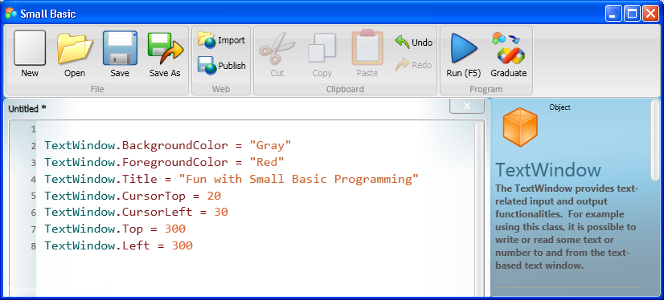
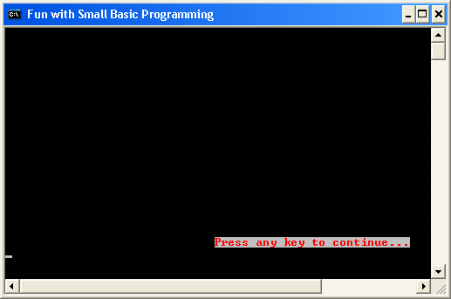
Properties of the TextWindow Object
The TextWindow object has a specific set of properties, such as ForegroundColor, BackgroundColor, Title, CursorTop, CursorLeft, Top, and Left. You can use these properties to change how and where the TextWindow object appears.
output
Notes:
In the previous screen, we talked about an object called TextWindow. Small Basic contains many more objects. These objects have certain properties, operations, or events attached to them.
Let’s understand the properties and operations of a text window and how we can use them.
In the code that appears here, you set the background color of the TextWindow object to gray and the foreground color to red. Similarly, you specify a title for the text window, the position of the cursor in the text window, and the location where you want the window to appear on the screen.
To better understand this code, let’s check the output of your program after you run it!
As you see in the output, the default text Press any key to continue… appears in red with a gray background. This is because you set the BackgroundColor property of the text window to Gray and the ForegroundColor property to Red.
Notice that the title of the text window is Fun with Small Basic Programming. You specified this title by using the Title property of the TextWindow object.
The CursorTop property indicates the row position of the cursor in the text window, and the CursorLeft property indicates the column position of the cursor. You had set these values by using the CursorTop and CursorLeft properties.
Similarly, the Top property and the Left property indicate the top position and the left position of the text window on the screen.
Code:
TextWindow.BackgroundColor = "Gray"
TextWindow.ForegroundColor = "Red"
TextWindow.Title = "Fun with Small Basic Programming"
TextWindow.CursorTop = 20
TextWindow.CursorLeft = 30
TextWindow.Top = 300
TextWindow.Left = 300

Slide 20
Operations of the TextWindow Object
For the TextWindow object, you can specify the following operations:
Show
Hide
Write
WriteLine
Read
Pause
Clear
Let’s explore some of these operations…
Notes:
In addition to the Show and Hide operations, you can also perform other actions or operations on the TextWindow object.

Slide 21

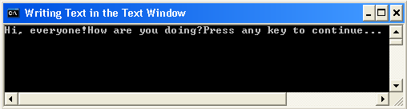
Writing Text in the Text Window
You have already learned how to show and hide the text window. Now let’s see how you can write text in the TextWindow object.
As you see, this operation wrote both sentences on the same line with no space between them. But don’t worry: you can use a different operation to show these sentences on separate lines.
Notes:
You can write text in the text window by using the Write operation of the TextWindow object.
Code:
TextWindow.Write("Hi, everyone!")
TextWindow.Write("How are you doing?")

Slide 22
What does this command do?

Slide 23

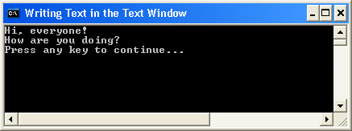
Writing Text in the Text Window
Write and WriteLine are both operations of the TextWindow object. If you use the WriteLine operation, each line of text appears on a separate line.
Notes:
To write the text on separate lines, you use the WriteLine operation.
Code:
TextWindow.WriteLine("Hi, everyone!")
TextWindow.WriteLine("How are you doing?")

Slide 24
How is this different?

Slide 25
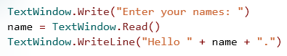
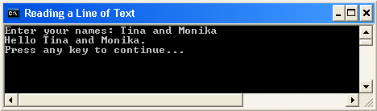
Reading a Line of Text
Would you like the computer to ask for your name and a friend’s name and then say "Hello" to both of you? Let’s see how to make that happen.
If you use the Read operation, the computer reads and remembers what a user has typed. If you use the WriteLine operation, the computer displays the information from the user.
Notes:
The Read operation of the TextWindow object takes no input. This operation instructs the computer to wait while the user types in text and then presses ENTER. After the user presses ENTER , the program reads what the user has typed and stores it in memory. You can then use the Write operation or the WriteLine operation to display the stored information.
Code:
TextWindow.Write("Enter your name: ")
name = TextWindow.Read()
TextWindow.WriteLine("Hello " + name + ".")

Slide 26
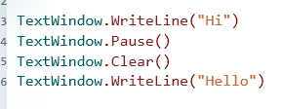
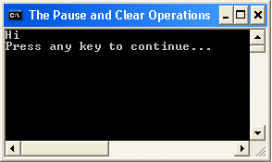
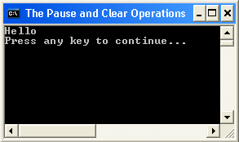
The Pause and Clear Operations
If you use the Pause operation, the computer waits for user input before returning the final output.
If you use the Clear operation, the computer clears all text from the text window.
Let’s write a program to better understand these operations.
Notes:
When the program starts, the computer reads the first statement, which contains the first WriteLine operation. The computer opens the text window and writes the word “Hi” in it.
The computer then reads the second statement, which contains the Pause operation. The computer pauses and waits for user input.
After the user provides input, the computer reads the third statement, which contains the Clear operation. The computer clears the word “Hi” from the text window.
Finally, the computer reads the last statement, which contains the second WriteLine operation. The computer writes the word “Hello” in the text window.
Code:
TextWindow.WriteLine("Hi")
TextWindow.Pause()
TextWindow.Clear()
TextWindow.WriteLine("Hello")

Slide 27
What is a variable?

Slide 28

Let’s Summarize…
Congratulations! Now you know how to:
Write statements for programs in Small Basic.
Change various properties of the TextWindow object, such as its title and its location.
Use various operations of the TextWindow object, such as Show and WriteLine.

Slide 29
Show What You Know
Write a program to display a text window and perform the following steps:
Set the top position of the text window to 100, and set its left position to 200.
Write a statement that makes “Small Basic Programming” appear in the title bar of the text window.
Set the top position of the cursor to 10 and left position to 20.
Set the foreground color of the text to yellow.
Display the sentence, “Welcome to the world of Small Basic programming.”
Notes:
Solution:
TextWindow.Top = 100 TextWindow.Left = 200 TextWindow.Title = "Small Basic Programming" TextWindow.CursorTop = 10 TextWindow.CursorLeft = 20 TextWindow.ForegroundColor = "Yellow" TextWindow.WriteLine("Welcome to the world of Small Basic programming.")

Slide 30
Solution:
TextWindow.Top = 100 TextWindow.Left = 200 TextWindow.Title = "Small Basic Programming" TextWindow.CursorTop = 10 TextWindow.CursorLeft = 20 TextWindow.ForegroundColor = "Yellow" TextWindow.WriteLine("Welcome to the world of Small Basic programming.")

Slide 31
Microsoft® Small Basic
Variables
Estimated time to complete this lesson: 1 hour

Slide 32

Variables
In this lesson, you will learn how to:
Define and name a variable.
Use variables to store text or numbers.
Use arrays to store multiple values.

Slide 33

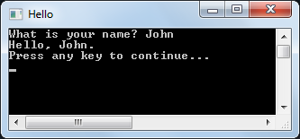
What is a Variable?
You can use a variable to store different kinds of information, such as text or a number. A variable can contain different values at different points in time. Most variables can contain only one value at a time. However, special variables, which are called arrays, can contain more than one value. Let’s look at a program in which you create a variable to store the user’s name.
In this example, your program asks the user to type his or her name. Your program uses a variable that is called "name“ to store the information.
Click the button on the toolbar.
When you run your program, it displays “Hello” and then the information in the variable.
Notes:
A variable temporarily stores a value that your program can use later. If you run a program again but assign a different value to the variable, the new value in the variable replaces the old value.
When you run a program, the value in the variable is also used as you specify in the code. You can reuse a variable as many times as your program requires.
Code:
TextWindow.Write("What is your name? ")
name = TextWindow.Read()
TextWindow.WriteLine("Hello, " + name + ".")

Slide 35

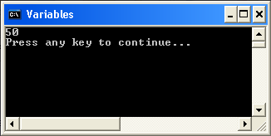
How to Name a Variable?
You should follow these rules and guidelines when you create your variables.
You should always start variable names with a letter.
You can use letters, digits, and underscores in the names of your variables.
You should name your variables so that they describe the values that they store.
When you name your variables, you should not include certain reserved words, such as If, For, and Then.
output
Notes:
You can identify your variables more easily if you give them suitable names.
Code:
number_1 = 20
number_2 = 30
number_sum = number_1 + number_2
TextWindow.WriteLine(number_sum)

Slide 36
EXT: Can you write a program using variables to write 2^{0,} 2¹, 2², 2³, 2⁴, 2⁵ etc…

Slide 37
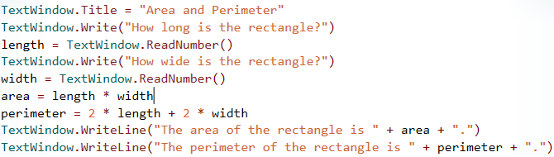
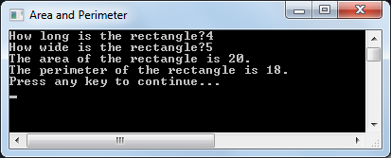
Storing Numerical Values In a Variable
To better understand variables that store numbers, let’s write a simple program that calculates the area and perimeter of a rectangle.
output
The program asks the user to specify the length and width of the rectangle. When the user presses ENTER, the program calculates and displays the area and perimeter values of the rectangle.
Notes:
In the previous example, you used a variable to store text, which is also known as a string. Now let’s see an example of how to store numerical values in variables.
In this example, you use the Write operation to ask the user to specify the length and width of a rectangle. You also create variables that you name length and width, and you use the ReadNumber operation to instruct the computer to store the user’s answers in those variables. Then you create variables that you name area and perimeter, and you instruct the computer to calculate the area and perimeter of the rectangle and store those values in the appropriate variables. Finally, you use the WriteLine operation to display the results.
After you write the program, you can run it by clicking Run on the Toolbar or by pressing F5.
Code:
TextWindow.Title = "Area and Perimeter"
TextWindow.Write("How long is the rectangle? ")
length = TextWindow.ReadNumber()
TextWindow.Write("How wide is the rectangle? ")
width = TextWindow.ReadNumber()
area = length * width
perimeter = 2 * length + 2 * width
TextWindow.WriteLine("The area of the rectangle is " + area + ".")
TextWindow.WriteLine("The perimeter of the rectangle is " + perimeter + ".")

Slide 38
EXT: Can you write a program to work out the area of a circle?

Slide 39
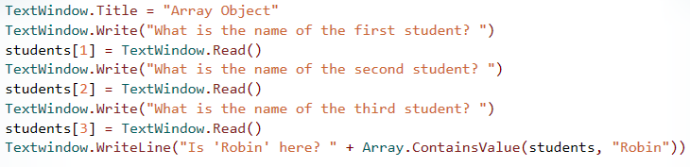
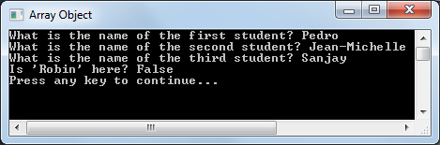
Storing Multiple Values In a Variable
You can store multiple values of the same type in a single variable by using an array. An array is a type of variable that can hold more than one value at a time. Let’s look at an example that uses an array.
In this example, you create an array that you name students, and you store three different names in it. You can then retrieve the stored values by using the various operations of the Array object.
You can use several other functions of the Array object in your program. You will learn more about these functions later.
Notes:
If you want to store multiple values of the same type, you can use an array instead of creating multiple variables. Then you can perform various operations on the values as a group.
In the example on this slide, you define an array that will contain names of students. Then you use an operation of the Array object to search the array for a specific value.
Code:
TextWindow.Title = "Array Object"
TextWindow.Write("What is the name of the first student? ")
students[1] = TextWindow.Read()
TextWindow.Write("What is the name of the second student? ")
students[2] = TextWindow.Read()
TextWindow.Write("What is the name of the third student? ")
students[3] = TextWindow.Read()
Textwindow.WriteLine("Is ‘Robin' here? " + Array.ContainsValue(students, "Robin"))

Slide 40
EXT: Can you change the program to use a variable for the check “Is Robin Here”?

Slide 41
Let’s Summarize…
Congratulations! Now you know how to:
Create and name variables, and write statements that contain variables.
Use variables to store text or numbers.
Use arrays to store multiple values of the same type.

Slide 42

Show What You Know
Write a program that calculates the area and circumference of a circle based on its diameter:
Ask the user to specify the diameter of a circle.
Create a variable that is called diameter, and store the value from the user in it.
Create a variable that is called radius, calculate the circle’s radius, and store the result in that variable.
Create variables that are called area and circumference, calculate the area and circumference of the circle, and store the values in those variables.
Display the area and circumference of the circle.
Notes:
You can use the following formulas for calculation:
radius = diameter / 2
area = (3.14) * radius * radius
circumference = (3.14) * 2 * radius
Solution:
TextWindow.Write("What is the diameter of the circle? ")
diameter = TextWindow.ReadNumber()
radius = diameter / 2
area = (3.14) * radius * radius
circumference = (3.14) * 2 * radius
TextWindow.WriteLine("The area of the circle is " + area + ".")
TextWindow.WriteLine("The circumference of the circle is " + circumference + ".")

Slide 43
https://codecombat.com/

